Slide 1
Xamarin Mobile Development
Matt Pasco

Slide 2
What is Xamarin?
Single Language (C#)
One Runtime
History
Originally MonoTouch
Became Xamarin
Acquired by Microsoft

Slide 3
Is it really native?
YES

Slide 4
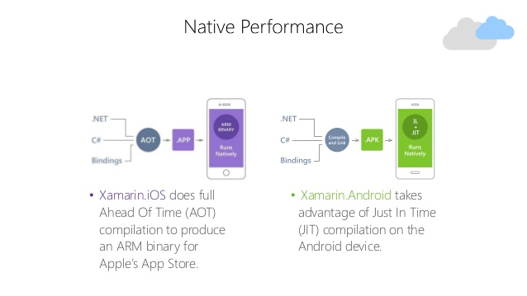
Wait if its not ObjC or Java how is it native?
All languages are C based
C# directly interacts with native types
Uses native tools to do build and compilation

Slide 5
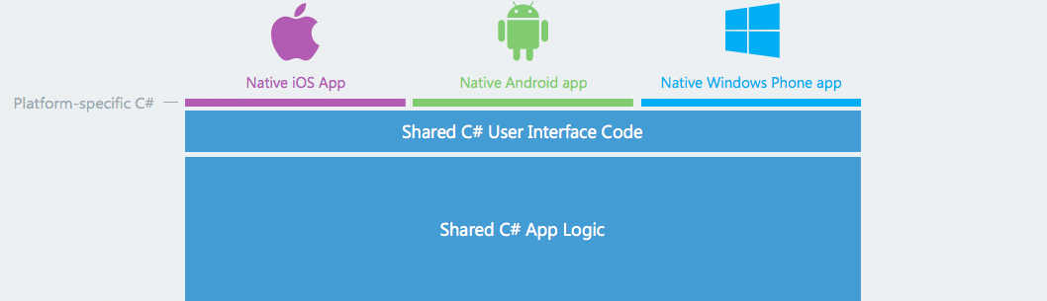
Why Xamarin?
Write your app logic once
No need to rewrite
API calls
Classes
Native
UI
API Access
Performance

Slide 6
What about Xamarin Forms?
One UI
Utilizes XAML
Uses shared subset of UI components
Button, Textbox, Labels, etc.
Platform specifics
Write native renders

Slide 7
What tools are needed?
Visual Studio Community or Visual Studio for Mac (Preview)
Both allow you to install tools for
Android
iOS
For Windows you can specify a remote Mac to
Compile your App
Run iOS emulator on Windows
All tools are free for students!

Slide 8
MSU Cafeteria Application

Slide 9
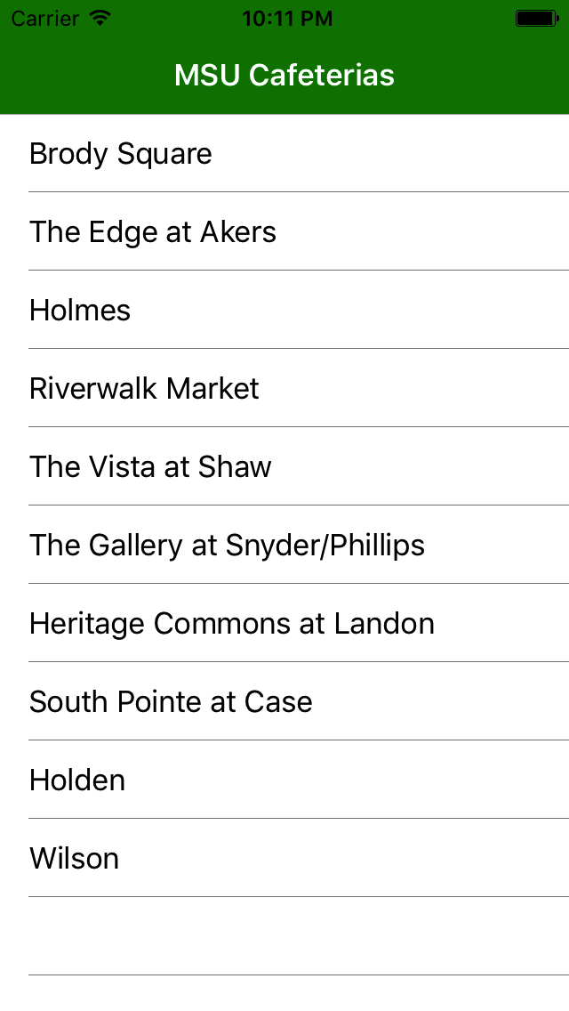
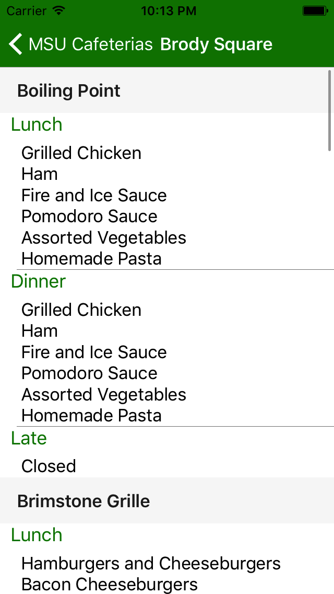
What we are building

Slide 10
MSU Cafeteria App
I don’t want to have to go to Eat At State’s website anymore
I want it to be native on my phone, table, and computer

Slide 11
GitHub
All code available here:
Available in steps

Slide 12
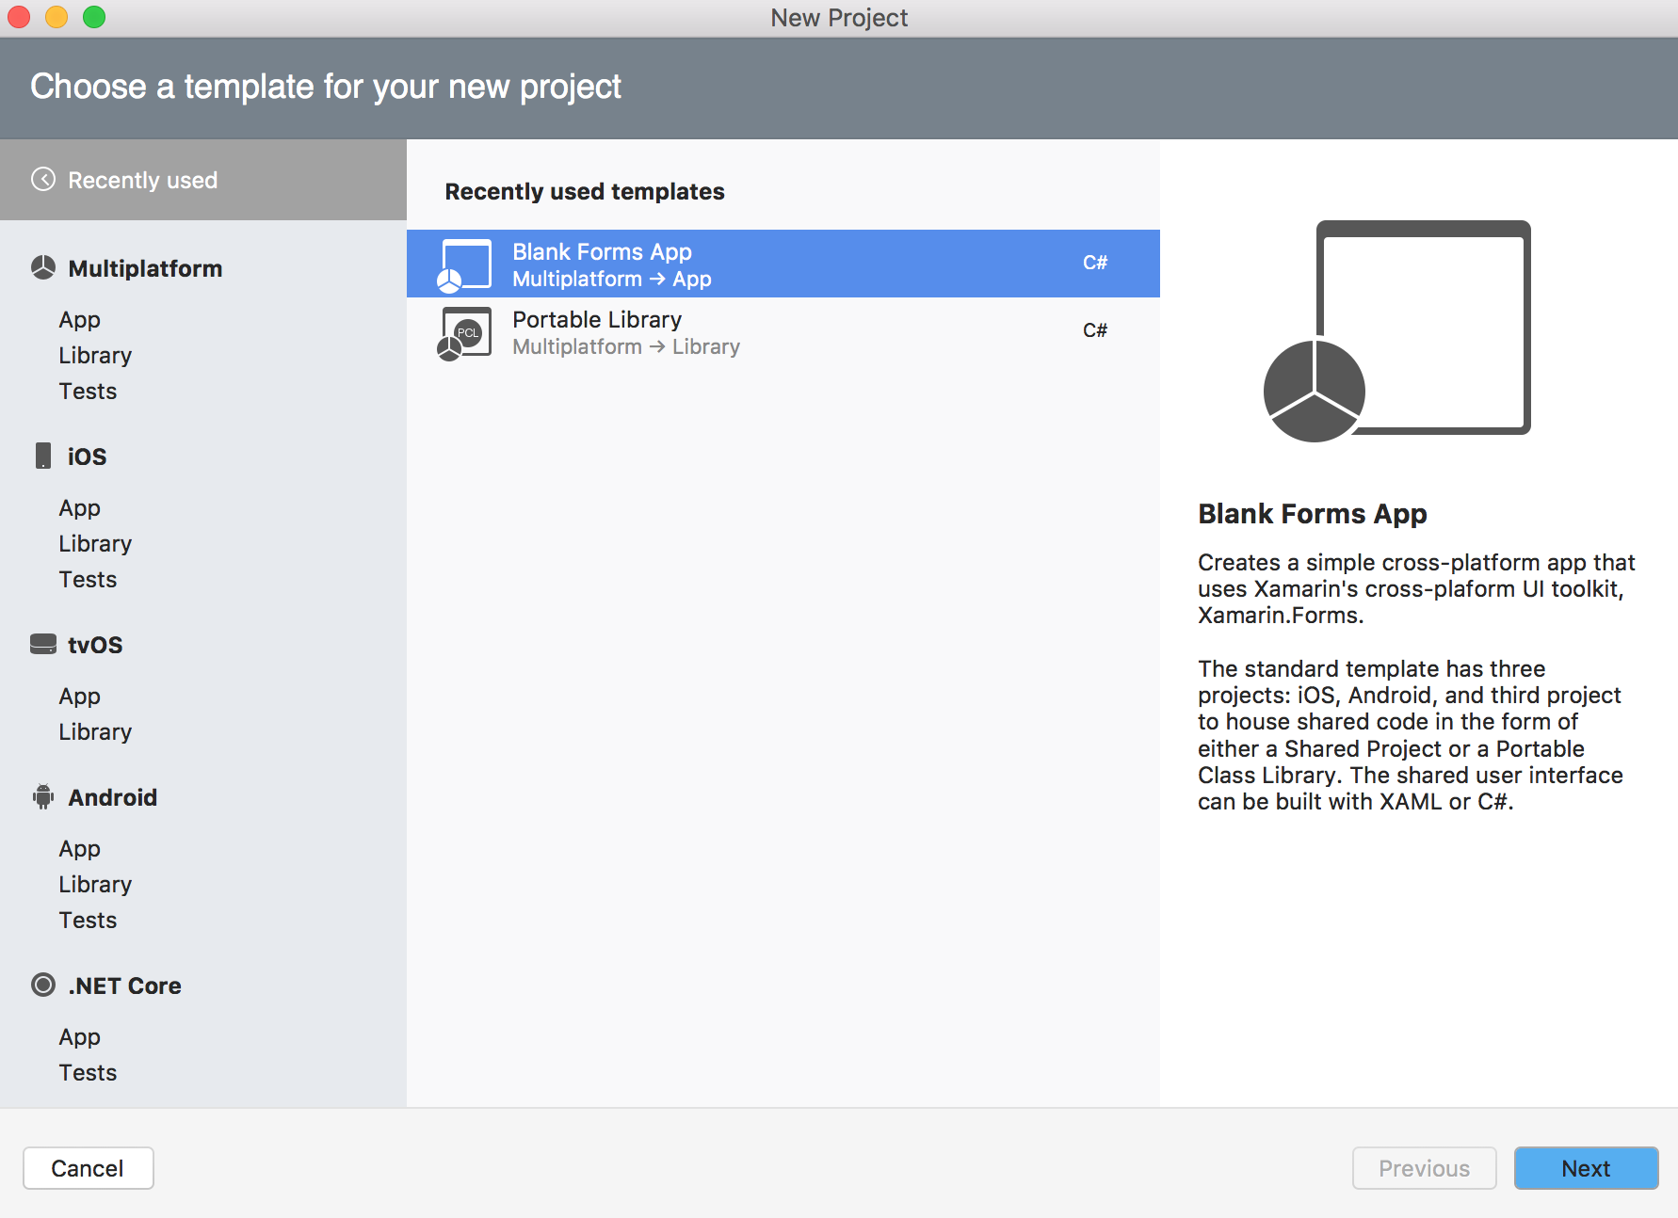
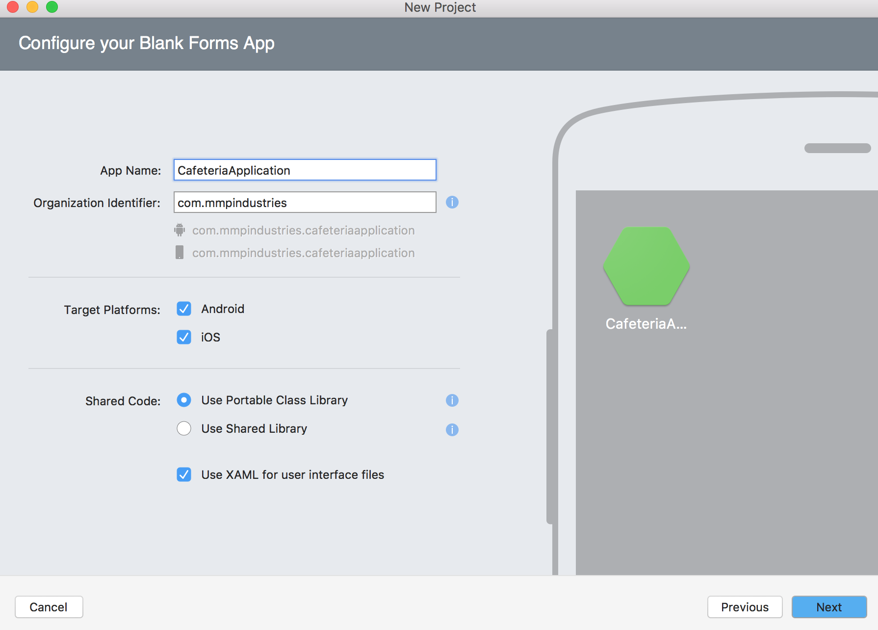
Create the Project

Slide 13
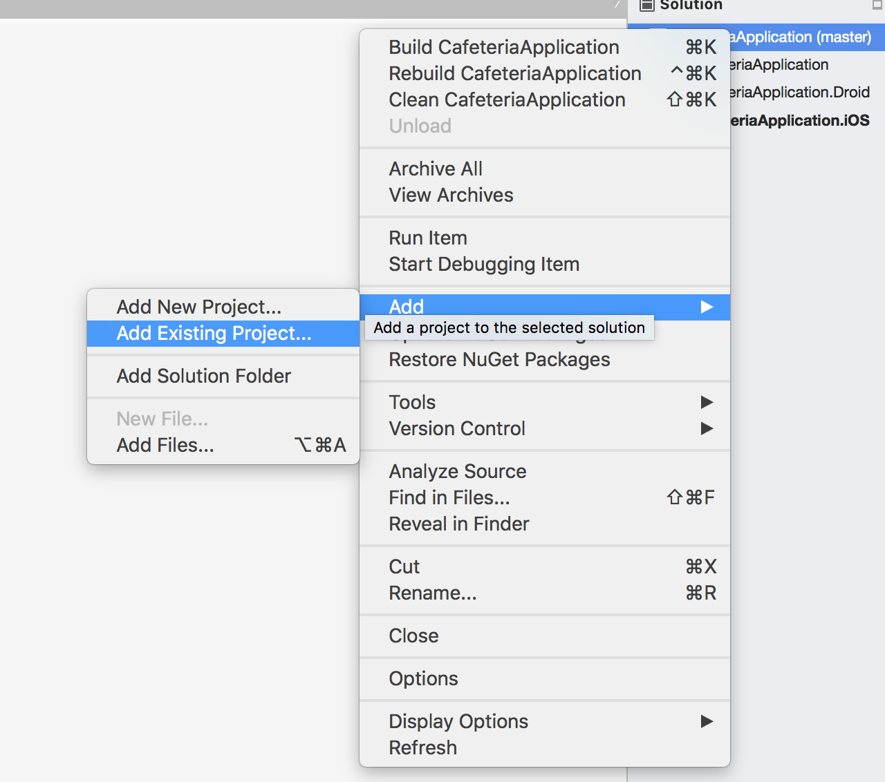
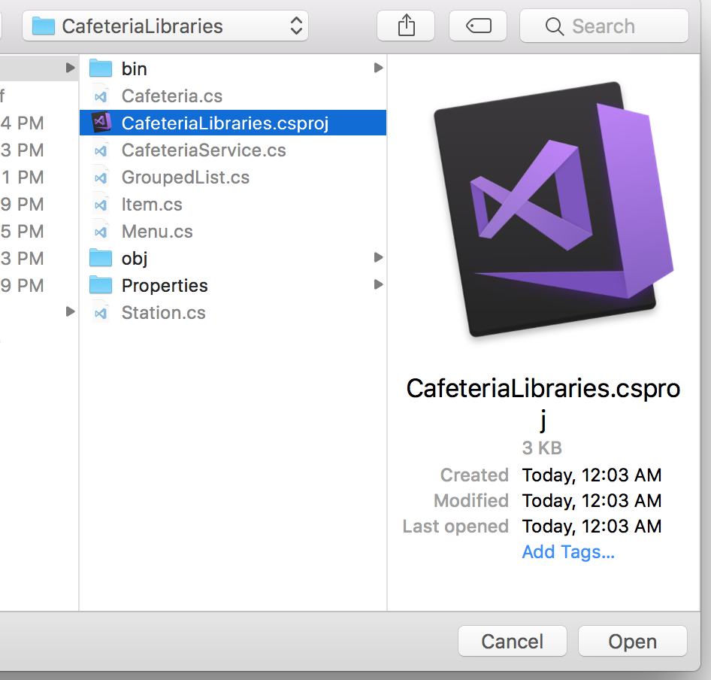
Add the logic libraries | CafeteriaLibraries
Right click on the solution -> Add -> Existing Project -> Navigate to CafeteriaLibraries project

Slide 14
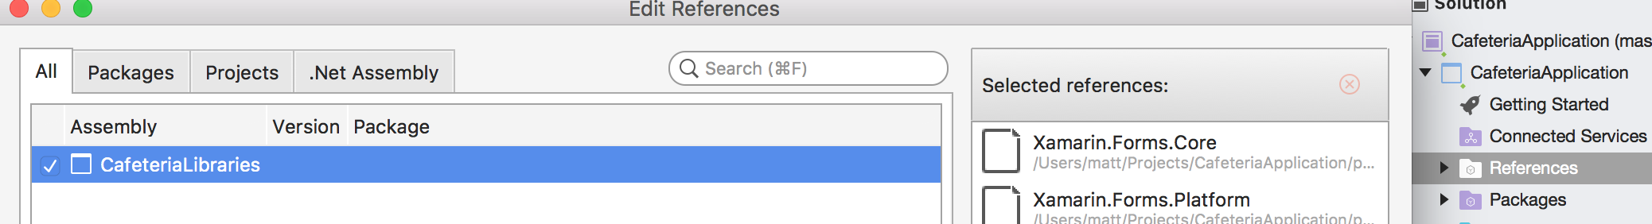
Add the reference to our Forms project
Select core project
Right click on references folder
Add
Select CafeteriaLibraries

Slide 15
Side Note LINQ
LINQ is a set of libraries that allow us to run queries on our objects inside .NET
It follows a SQL style query but can be formatted as Method calls

Slide 16
Side Notes on CafeteriaLibraries
Cafeteria
Name, string
The name of the cafeteria
Key, string
Used for calling webpage
Stations, ObservableCollection of type StationGroup
Will hold all of the cafeteria Stations
This is a list that will notify our UI upon change to the list

Slide 17
Side Notes on CafeteriaLibraries
CafeteriaService
GetCafeterias(), return List of Cafeterias
This function returns all of the cafeterias
GetCafeteria(Cafeteria), return Cafeteria
Get the Menu for the inputted cafeteria

Slide 18
Side Notes on CafeteriaLibraries
MealType
Enumerable
Breakfast
Lunch
Dinner
Late (Late night)

Slide 19
Side Notes on CafeteriaLibraries
MenuItem
Name, string
The name of the menu item
Meal, MealType
The meal of the menu item

Slide 20
Side Notes on CafeteriaLibraries
MenuItemGroup
Meal, MealType
All menu items will be this
MenuItems, list of MenuItem
List to hold all of the menu items
MenuString, string
LINQ Query to aggregate all Menu Items of a station for a given meal into a string
Each menu item is separated by a newline
This is used to hold all of the items for a given meal

Slide 21
Side Notes on CafeteriaLibraries
StationGroup
Inherits from ObservableCollection<MenuItemGroup>
StationName, string

Slide 22
Are you bored yet?
We will start building out our app
We need:
A main page that will show a list of Cafeterias
A page that will show all of the stations menus for a cafeteria

Slide 23

UI BreakDown
Navigation Bar
Navigation
Page
lsvCafeterias (ListView)
ItemSource: Cafeterias
CafeteriaApplicationPage
TextCell
Text: Cafeteria.Name

Slide 24
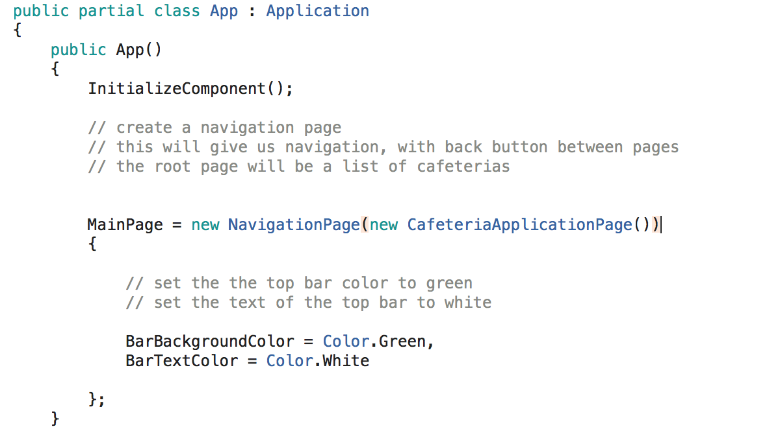
NavigationPage
We want to have navigation built in so we can swap between pages
In app.xaml.cs

Slide 25
Main page | CafeteriaApplicationPage
We will have a list that will hold all of our Cafeterias
This object is called a ListView
We will use databinding
Databinding is a type of MVC (called MVVM)
It will connect a property of an object to a UI object property
Ie. Name of cafeteria to Text of TextCell

Slide 26
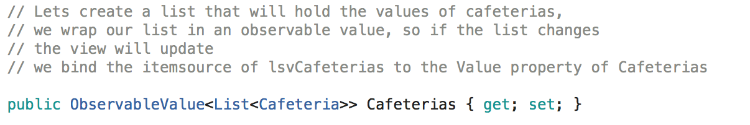
Main page | CafeteriaApplicationPage
We want a List that will hold our cafeterias
We want to notify the UI when the data is set, so it can refresh
Custom Class ObservableValue

Slide 27
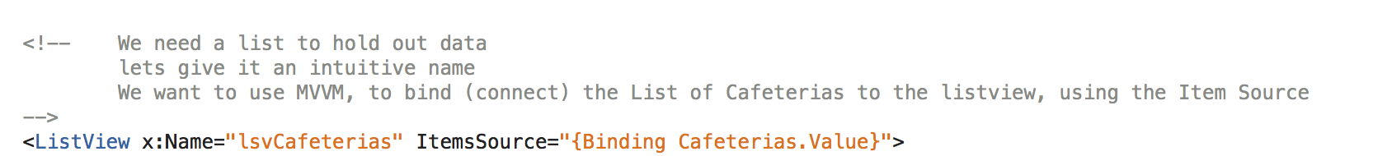
Main page | CafeteriaApplicationPage
Setting up our Listview to bind to our List
ItemsSource to our Cafeteria List

Slide 28
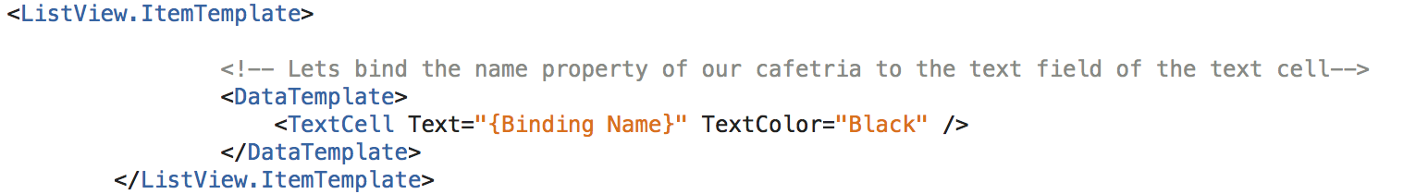
Main page | CafeteriaApplicationPage
Lets bind our Cafeteria object to an item (TextCell) in our ListView
Cafeteria.Name->Text

Slide 29
Main page | CafeteriaApplicationPage
Now we need an object to get our list of cafeteria
CafeteriaService

Slide 30
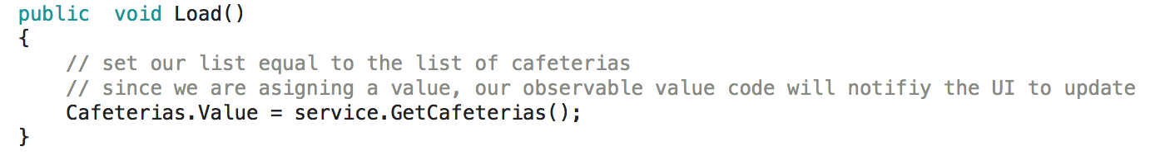
Main page | CafeteriaApplicationPage
Function to load the Data, we can also use this if we implement a button or pull to refresh

Slide 31
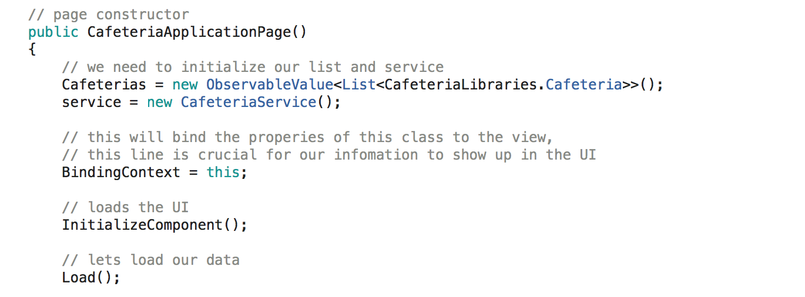
Main page | CafeteriaApplicationPage
Constructor
CafeteriaApplicationPage.xaml.cs

Slide 32
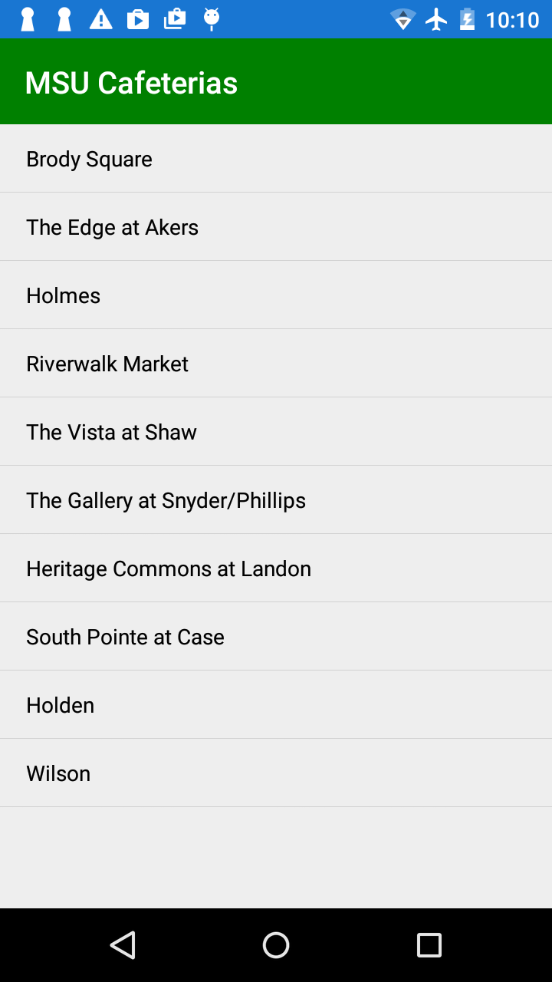
Lets test it out

Slide 33
UI BreakDown
Navigation Bar
Navigation
Page
lsvCafeterias (ListView)
ItemSource: Cafeterias
CafeteriaApplicationPage
TextCell
Text: Cafeteria.Name

Slide 34
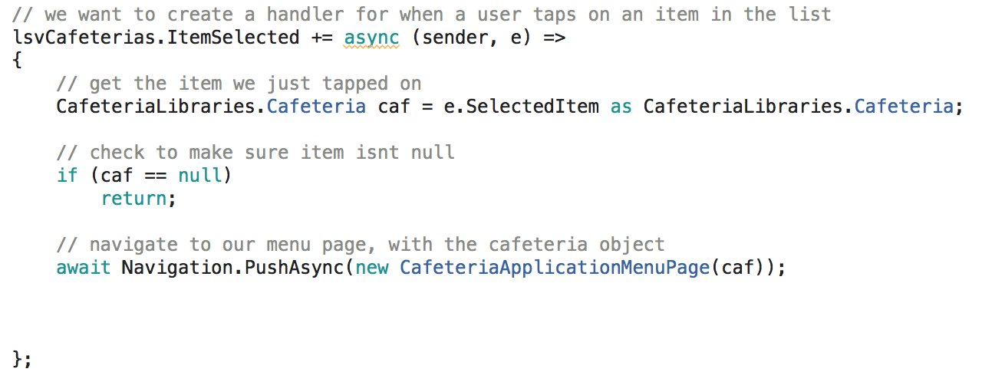
Main page | CafeteriaApplicationPage
Constructor, handling user selection
CafeteriaApplicationPage.xaml.cs

Slide 35
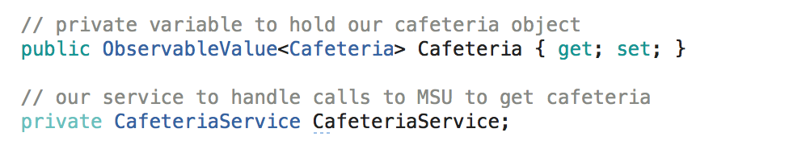
Information page | CafeteriaApplicationMenuPage
A variable that will hold our Cafeteria object
This will contain a List of Stations
A variable to make our CafeteriaService Calls
CafeteriaApplicationMenuPage.xaml.cs

Slide 36
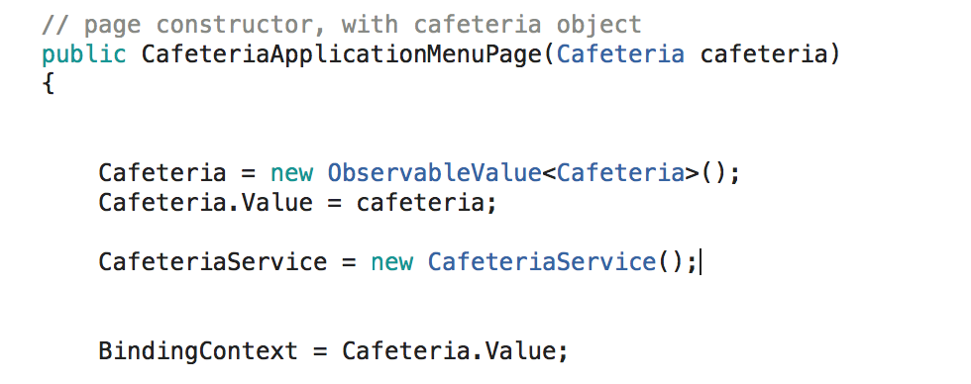
Information page | CafeteriaApplicationMenuPage
Constructor
Will take in a Cafeteria object from root page
Assign it to our Cafeteria Property
We will connect our View to our Cafeteria property
CafeteriaApplicationMenuPage.xaml.cs

Slide 37
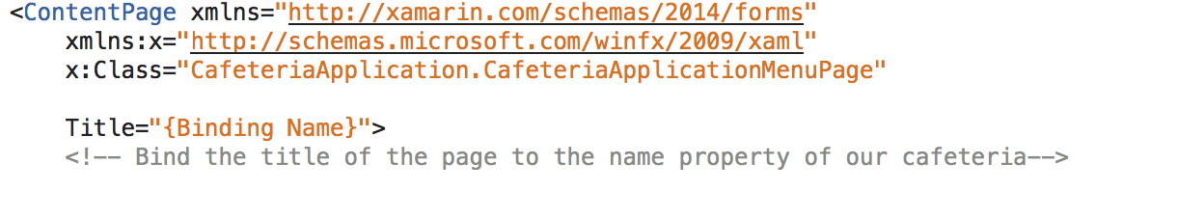
Information page | CafeteriaApplicationMenuPage
Bind the page Title to our Cafeteria Name
CafeteriaApplicationMenuPage.xaml

Slide 38
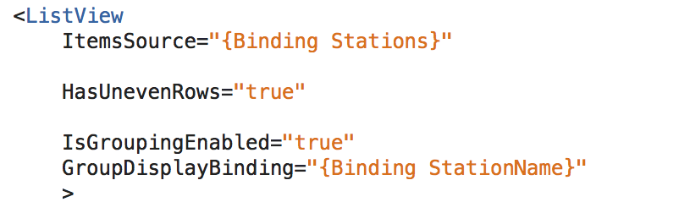
Information page | CafeteriaApplicationMenuPage
Our ListView will be bound to our cafeteria’s stations
Our Rows will contain all items for a given mean
We want grouping, our group headers will be our station names
CafeteriaApplicationMenuPage.xaml

Slide 39
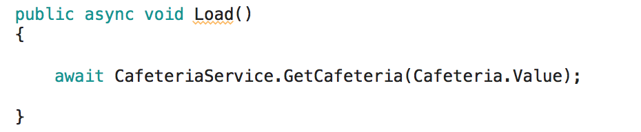
Information page | CafeteriaApplicationMenuPage
Load Cafeteria Data
Use our service to call the feed with our cafeteria object
CafeteriaApplicationMenuPage.xaml.cs

Slide 40
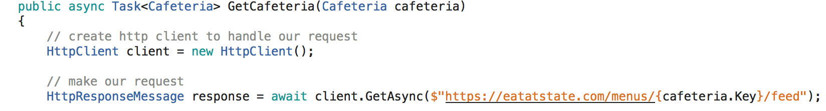
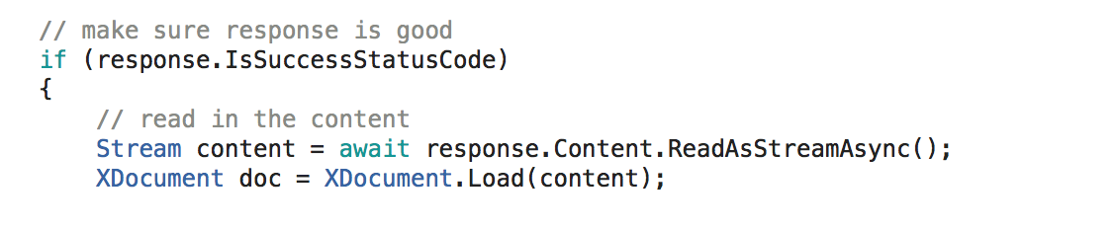
Pulling down the Data
CafeteriaService.GetCafeteria(Cafeteria)
Handle the response
CafeteriaService.cs

Slide 41
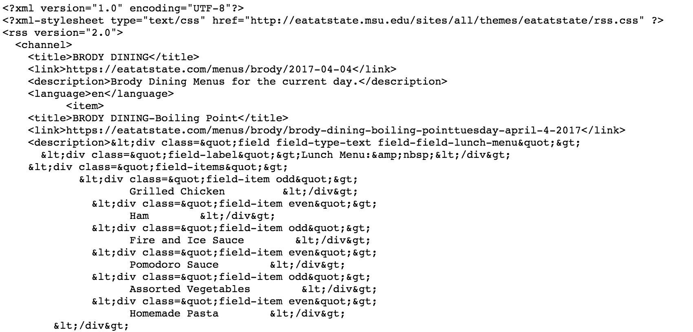
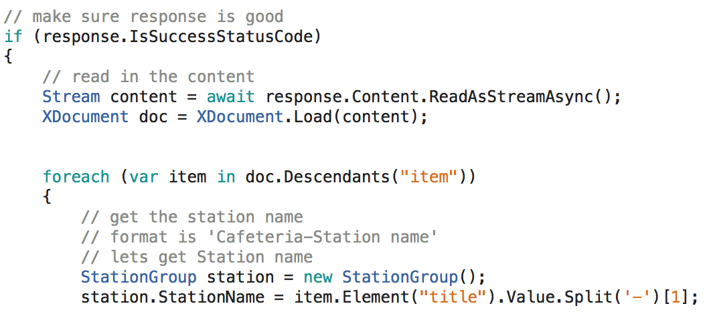
Pulling down the Data
Reading the XML
Well need to parse out the content from the HTML
Items == Stations
Well get the stations name, which is CafName-StationName
CafeteriaService.cs

Slide 42
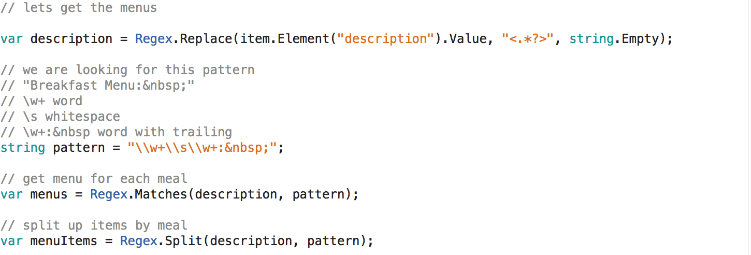
Pulling down the Data
All of the menu information is contained inside the Description Tag
Each Meal’s menu begins with this
CafeteriaService.cs

Slide 43
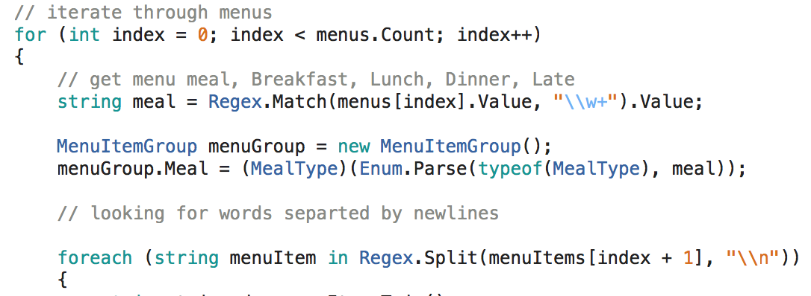
Pulling down the Data
Get Meal Title
Get Menu Items, separated by newlines
CafeteriaService.cs

Slide 44
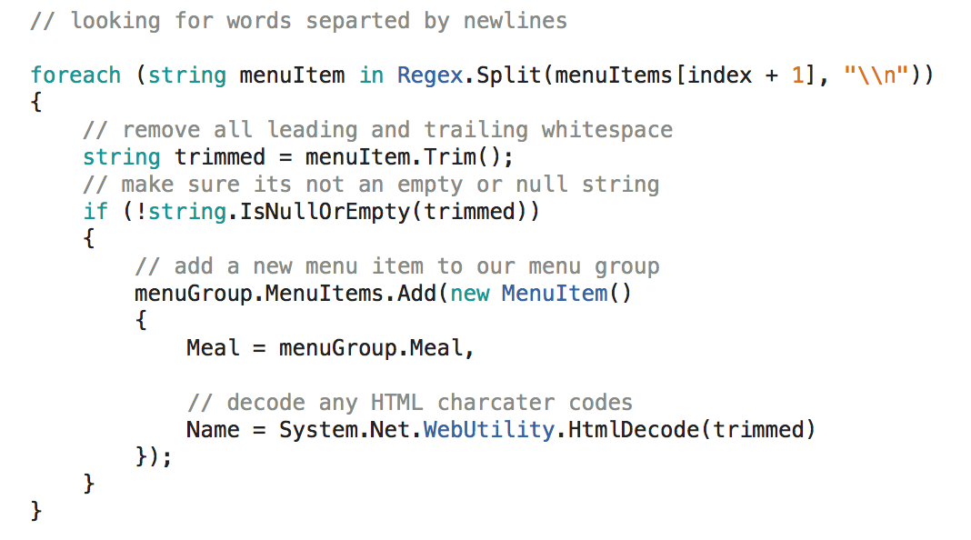
Pulling down the Data
Iterate through our collection of words
Remove any whitespace
Decode any HTML characters like !’;,
CafeteriaService.cs

Slide 45
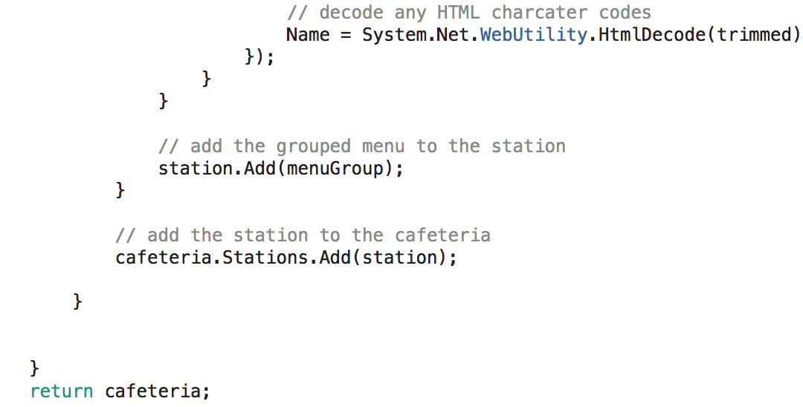
Pulling down the Data
Finally add the grouped menus to the station
Once all menus added, add station to cafeteria object
CafeteriaService.cs

Slide 46
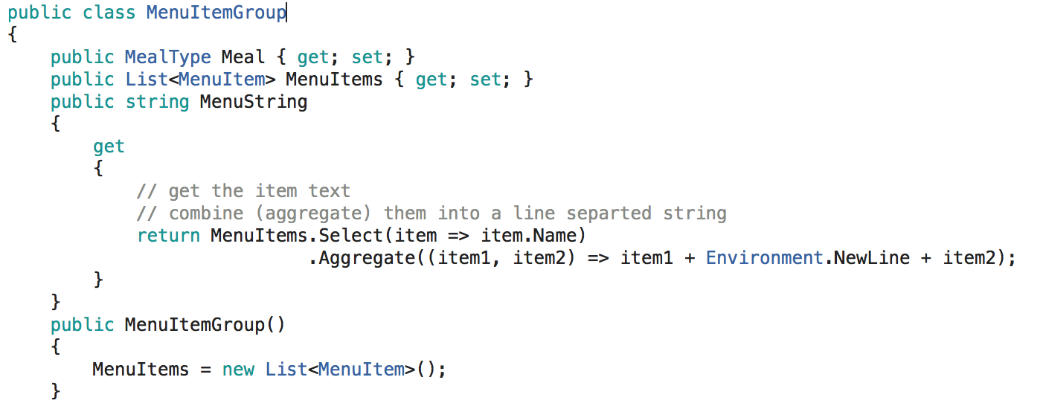
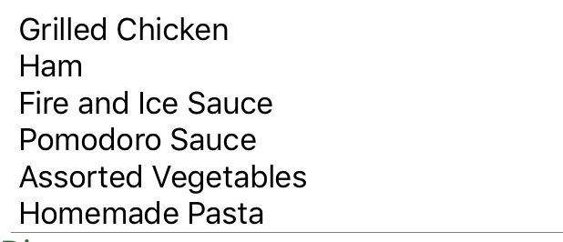
Menu Group
Now we have our collection of MenuItems, we want to have them as a String so one meal will appear as one row.
This will put each MenuItem Name in a string separated by new line

Slide 47
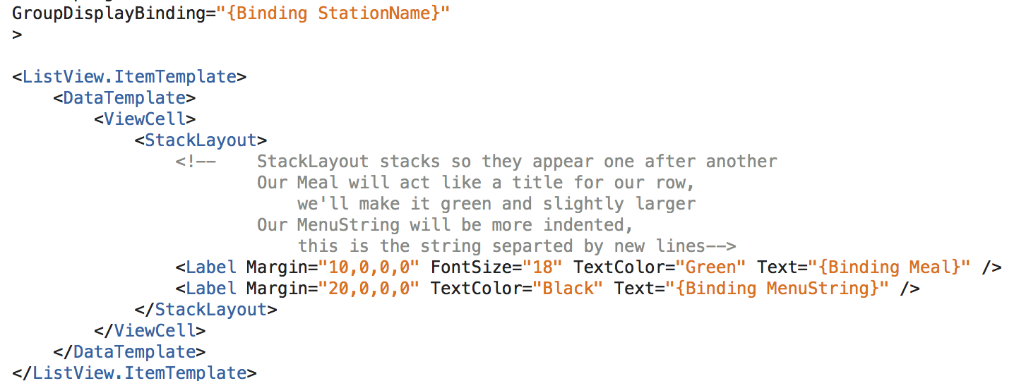
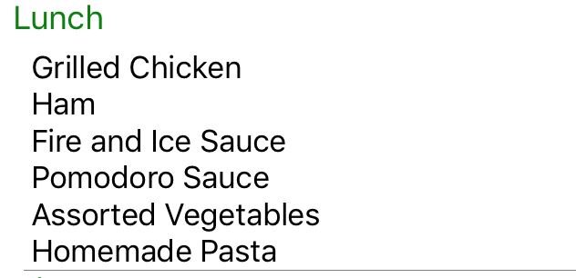
Information page | CafeteriaApplicationMenuPage
Designing a row in the list view
CafeteriaApplicationMenuPage.xaml

Slide 48

Information page | CafeteriaApplicationMenuPage
CafeteriaApplicationMenuPage.xaml

